Slide 1
DNA, RNA
&
Protein Synthesis

Slide 2
Major Cell Activities Include:
Diffusion
Osmosis
Active Transport
Cell Energy
  Photosynthesis
  Cell Respiration
  ATP
DNA Replication
RNA Formation
Protein Synthesis
Cell Division
This unit covers these three

Slide 3
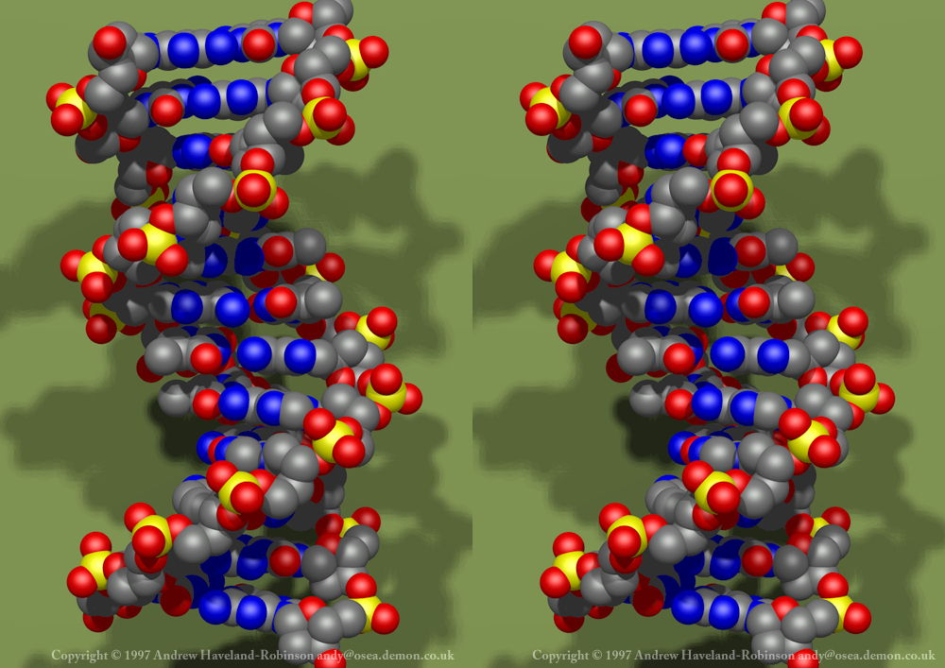
Nucleic acids
  Store & transmit genetic info
  DNA & RNA
  Composed of repeating units called nucleotides
DNA double helix

Slide 4
Nucleotides consist of:
  a sugar
  a phosphate group
  one nitrogen base
DNA
molecule
Nucleotide

Slide 5
E) The nitrogen bases are:
Adenine Thymine/Uracil
Cytocine Guanine
F) Order of the nucleotides determines genetics
A pairs with T (DNA) or U (RNA)
and C always pairs with G

Slide 6
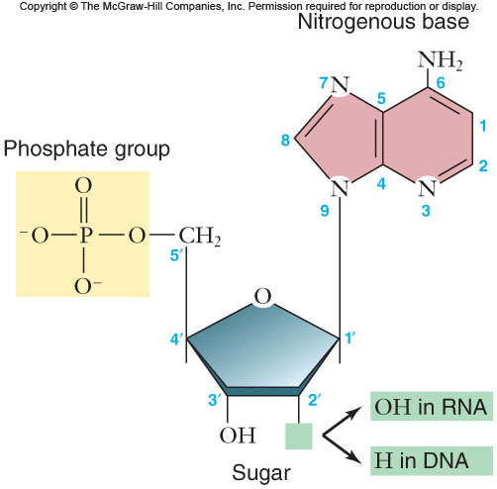
Nucleotide

Slide 7
II. DNA (Deoxyribonucleic Acid)
2 primary functions
  Control protein (enzyme) production (ie. ATPase)-These enzymes then control chemical reactions in cells.
  Duplicate itself for new cells that are created

Slide 8
Forms of DNA
  Chromatin –Partially unwound (normal cell activity)
  Chromosome – tightly wound DNA (Cell division)

Slide 9
DNA Structure
  Double Helix = Spiral ladder made up of nucleotides
    Sides of the ladder = 5 carbon sugar (deoxyribose) and phosphate
    Rungs of the ladder = nitrogen bases bonded together

Slide 10
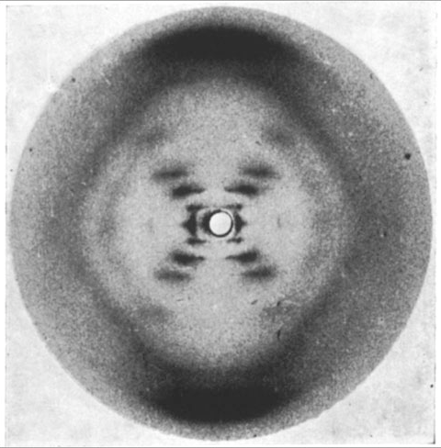
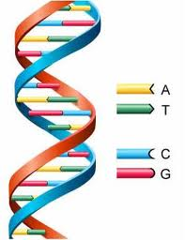
Rosalind Franklin’s X-ray Photo (1951)

Slide 11
Hydrogen bonds form between nitrogen bases, creating “steps” of ladder
  Adenine + Thymine = 2 hydrogen bonds
  =2 hydrogen bonds
  Cytosine + Guanine= 3 hydrogen bonds
  =3 hydrogen bonds
  Page 331
A
T
C
G

Slide 12
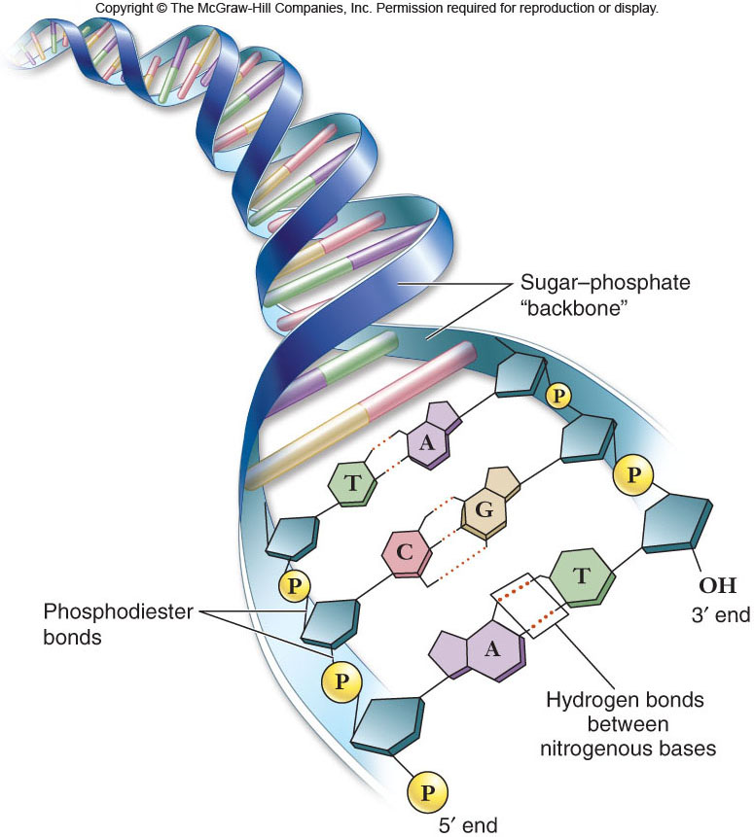
DNA

Slide 13
  DNA replication: each cell gets a copy of DNA when cells divide
    DNA untwists & unzips (helicase)
    Free nucleotides in the cell attach to complementary bases (DNA polymerase)
    The two copies separate and retwist into double helix

Slide 14
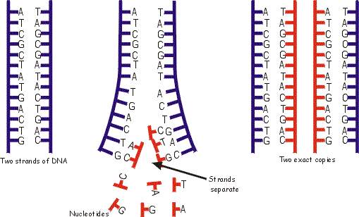
Final result = 2 exact copies of DNA
    * Each copy = 1 “old” strand and 1 “new” strand

Slide 15
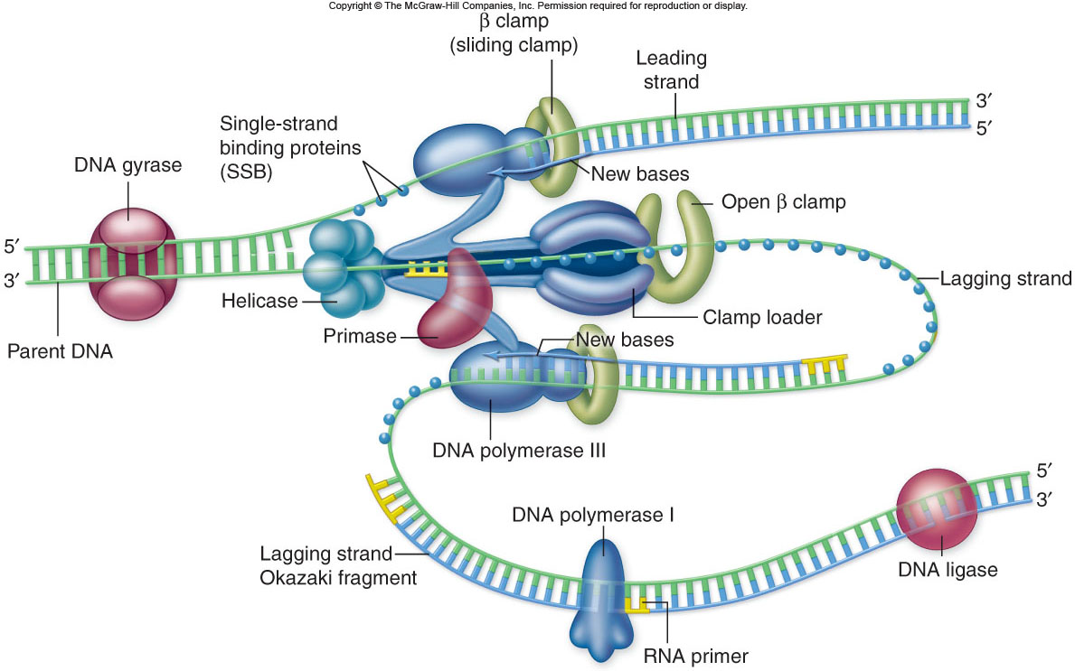

Slide 16
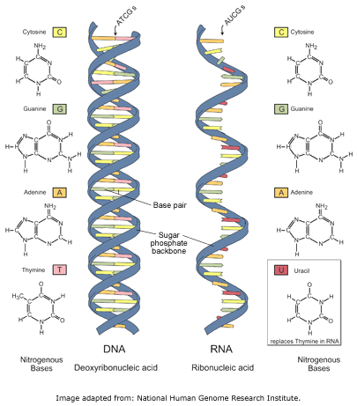
RNA (ribonucleic acid)
  RNA Structure
    Single stranded
    Sugar = ribose
    Contain U instead of T

Slide 17
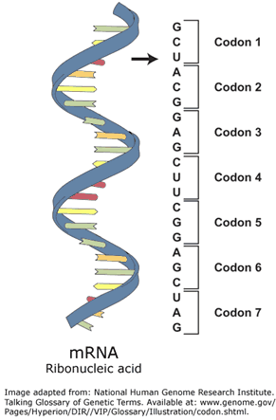
  3 Types
    Messenger RNA (mRNA)
      Transmits DNA information
      Serves as template (pattern) for making proteins
      Codon: set of 3 nitrogen bases

Slide 18
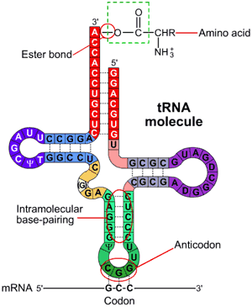
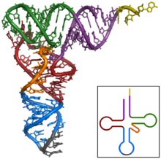
Transfer RNA (tRNA)
  Single folded strand
  Anticodon: set of 3 nitrogen bases that complement an mRNA codon
  Each tRNA carries a specific amino acid

Slide 19
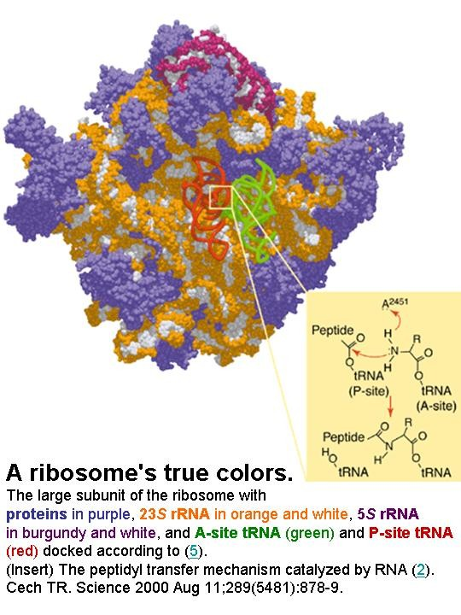
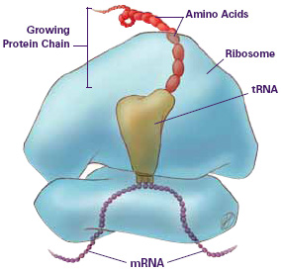
Ribosomal RNA (rRNA)
  Globular form
  Part of ribosome structure

Slide 20
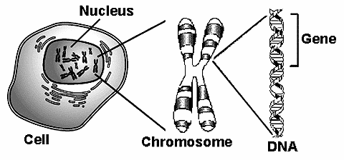
Protein synthesis
  using genetic information stored on DNA to produce new proteins
  One gene = “recipe” for one protein

Slide 21
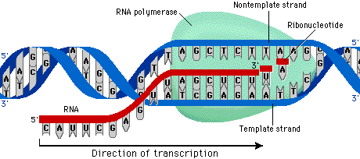
  Transcription (DNA → mRNA)
    DNA is too big to be used directly to make the protein, so a copy of a small DNA segment is made = mRNA

Slide 22
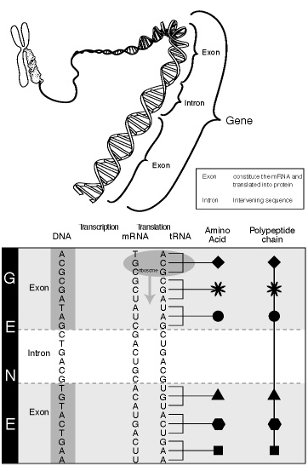
RNA processing
  Intron: DNA sequences that are not present in the final mRNA
  Exon: coding sequences that remain in the final mRNA
mRNA leaves the nucleus

Slide 23
Translation (mRNA → protein)
  mRNA lines up on a ribosome
  Codon: a set of 3 nitrogen bases, codes for one amino acid
  tRNA molecules carry the matching amino acids, which link together to form the new protein

Slide 24
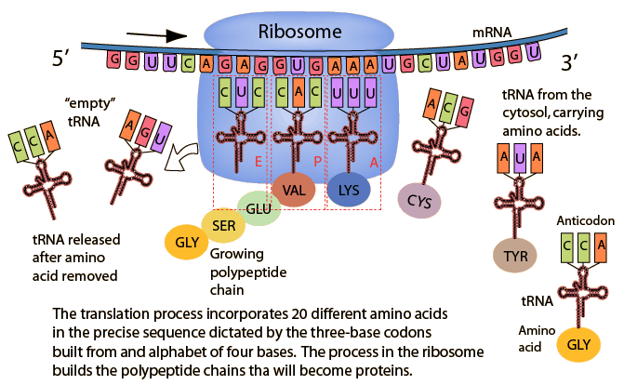

Slide 25
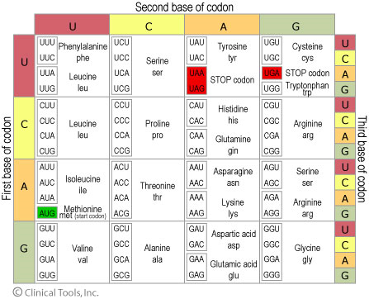

Slide 26
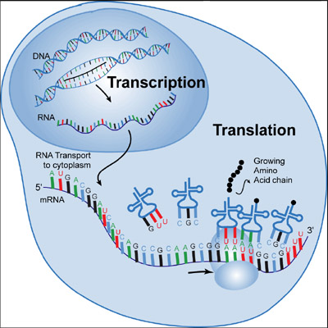
http://vcell.ndsu.nodak.edu/animations/transcription/movie.htm

Slide 27
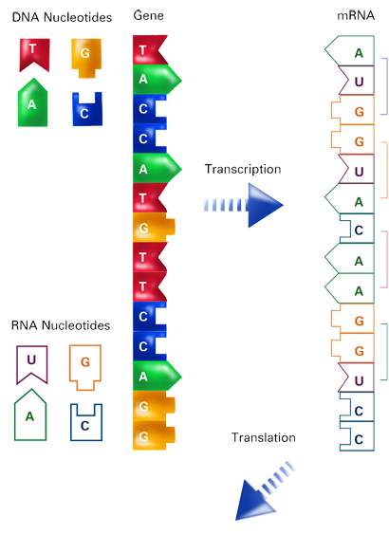
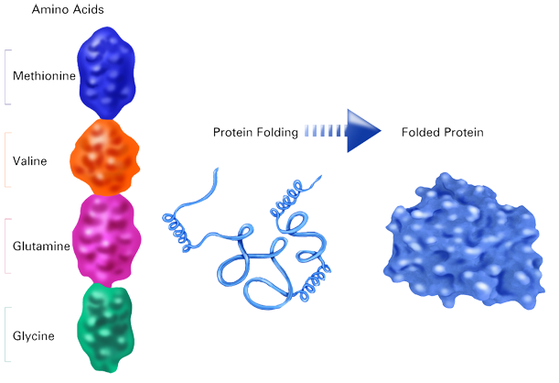
Transcription
Translation

Slide 28
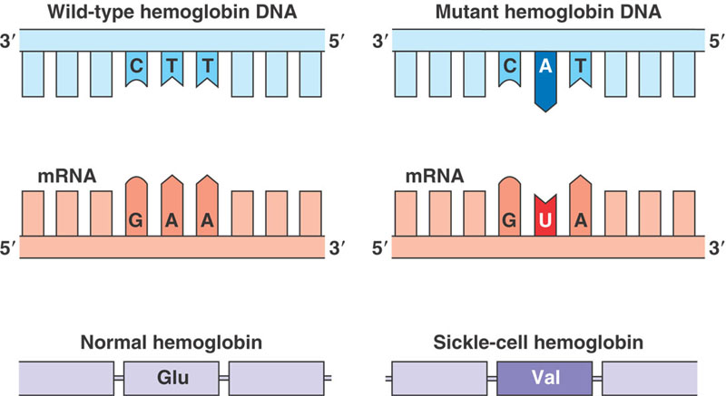
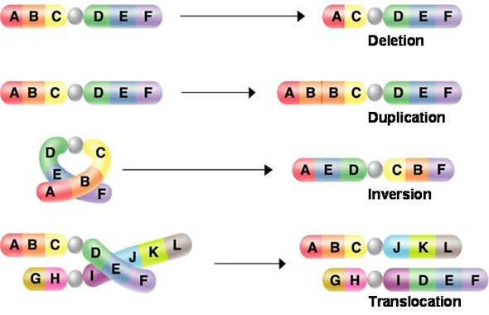
C. Mutation: permanent change in a cell’s DNA
1. examples include:
a) gain, loss, or replacement of a nucleotide
b) extra copies of codons
c) extra copies of genes
2. can lead to abnormal or missing proteins
3. examples: sickle cell anemia, Crohn’s disease
Point Mutation
Chromosomal Mutation

Slide 29
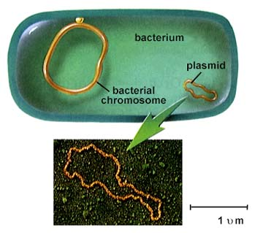
GENETIC ENGINEERING
Plasmids: circular double-stranded DNA
  Separate from chromosomal DNA
  Contain genes which code for less essential traits (ex. Adaptive traits)
  Common in bacteria

Slide 30
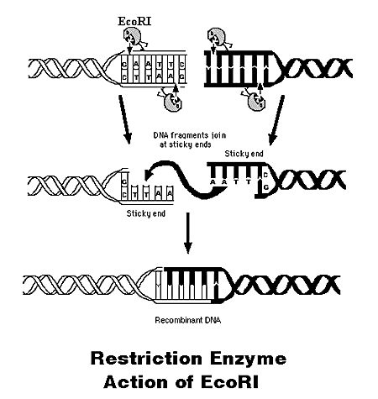
Recombinant DNA
  This is the union of DNA from 2 different organisms
  Restriction enzymes: cleave (cut) DNA into pieces

Slide 31
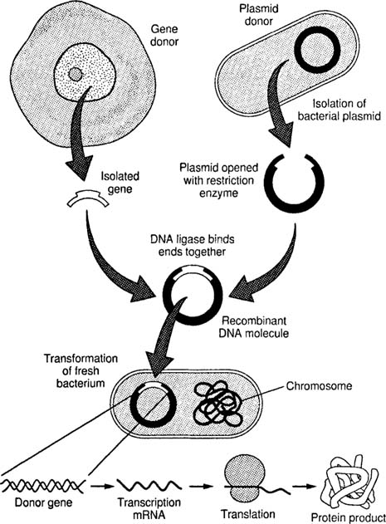
Procedure of recombinant DNA technology
  Isolate desired gene from a donor cell using RE
  Extract plasmid from bacterium and treat with RE
  “paste” desired gene “sticky” ends into plasmid opening
  Insert recombinant plasmid into healthy bacterium
  Allow bacteria to multiply
  Bacteria will transcribe and translate new gene, producing desired proteins

Slide 32
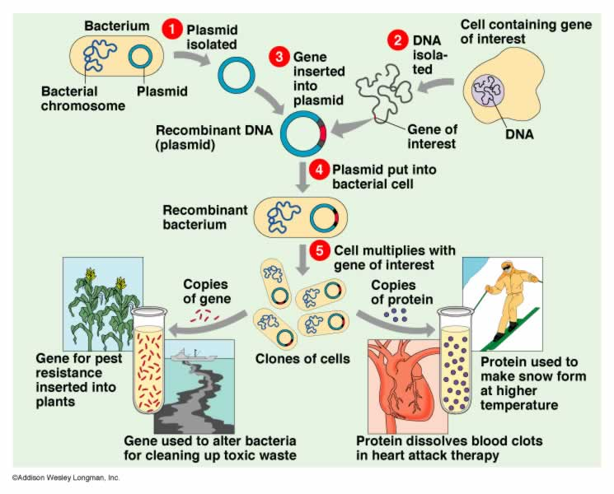
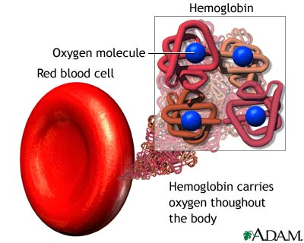
What are some desired proteins?
  Insulin
  Vaccines
  hemoglobin
  Hemoglobin molecular formula:
  C₃₀₃₂H₄₈₁₆O₈₇₂N₇₈₀S₈Fe₄
  Glycine (typical AA): C₂H₅N₁O₂

Slide 33
Some Products Made Using Biotechnology
Human growth hormone is used to treat dwarfism. It previously took the pituitary glands from over 50 cadavers to make one dose.
Human Insulin is used to treat diabetes.
Tissue plasminogen activator dissolves blood clots in heart attack victims.
Clotting factor VIII will soon be available. Most cases of hemophilia are due to the absence of this factor.
Human lung surfactant is used in premature infants with respiratory distress syndrome.
Atrial natriuretic hormone can be used to treat hypertension.
Bovine growth hormone (bGH) increases milk production in cows by about 10%.
A vaccine for hepatitis B is now produced using biotechnology.
Vaccines for chlamydia, malaria and HIV are being developed.
Vaccines for hoof-and-mouth disease and scours (a form of dysentery) have been developed for farm animals.
Bacteria have been produced that inhibit the formation of ice crystals. These bacteria have been released onto crop plants to protect them from frost damage.
A bacteria species that normally colonize corn roots have been given a gene that enables it to produce an insect-killing toxin.
Bacteria are being developed that do a better job at breaking down oil.
Bacteria have been developed that are capable of removing some kinds of toxins from the air and water.
Bacteria have been engineered to extract metals from low-grade ore (bioleaching).
there are 50 types of genetically engineered plants that resist insects, viruses, and herbicides.
A weed called mouse-eared cress has been designed to produce a biodegradable plastic called polyhydroxubutrate (PHB).
Pharmaceutical companies are developing techniques to produce chemicals using animals. The drug is produced in the milk of females. For example, goats have been developed to produce antithrombin III, used to prevent blood clots. Clinical trials of this drug will begin soon.
A pig has been produced that can produce human hemoglobin. Artificial blood may soon be a reality.

Slide 34
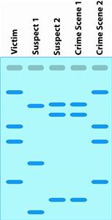
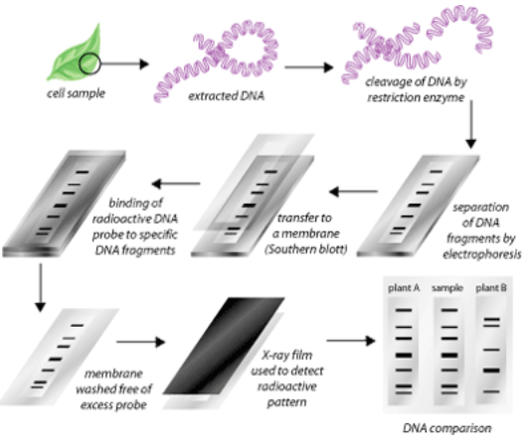
DNA fingerprinting
  Analysis of DNA sequences to determine identity

Slide 35
